Slide 1
Basis Sets and Pseudopotentials

Slide 2
Slater-Type Orbitals (STO’s)
N is a normalization constant
a, b, and c determine the angular momentum, i.e.
L=a+b+c
ζ is the orbital exponent. It determines the size of the
orbital.
STO exhibits the correct short- and long-range behavior.
Resembles H-like orbitals for 1s
Difficult to integrate for polyatomics

Slide 3
Gaussian-Type Orbitals (GTO’s)
N is a normalization constant
a, b, and c determine the angular momentum, i.e.
L=a+b+c
ζ is the orbital exponent. It determines the size of the
orbital.
Smooth curve near r=0 instead of a cusp.
Tail drops off faster a than Slater orbital.
Easy to integrate.

Slide 4
Contracted Basis Sets
P=primitive, C=contracted
Reduces the number of basis functions
The contraction coefficients, α_{i}, are constant
Can be a segmented contraction or a general contraction
Notes:
Jensen p. 201

Slide 5
Contracted Basis Sets
 | Segmented Contraction |  |  | General Contraction
 | CGTO-1 | CGTO-2 | CGTO-3 | CGTO-1 | CGTO-2 | CGTO-3
PGTO-1
PGTO-2
PGTO-3
PGTO-4
PGTO-5
PGTO-6
PGTO-7
PGTO-8
PGTO-9
PGTO-10
Jensen, Figure 5.3, p. 202
Notes:
Jensen p. 201. Note that in segmented contractions (all Pople basis sets) there is no sharing of pirmitives – less computationally expensive. In general contractions, all basis functions use all primitives (Dunning basis sets): more computationally expensive.

Slide 6
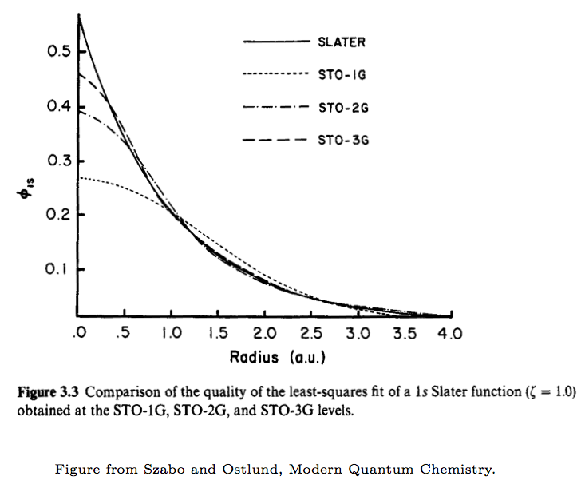
STO-NG: STO approximated by linear combination of N Gaussians
Notes:
Note nuclear cusp for STO

Slide 7
Even-tempered Basis Sets
Same functional form as the Gaussian functions used earlier
The exponent, ζ, is fitted to two parameters with different
α and β for s, p, d, etc. functions.
Successive exponents are related by a geometric series
- log(ζ) are evenly spaced
Reudenberg, K., et Al., Energy, Structure and Reactivity, Proceedings of the 1972
Boulder Conference; Wiley: New York, 1973.
Reeves, C. M. J. Chem Phys. 1963, 39, 1.
Notes:
Redo this slide – See Jensen book (p. 198). Usually means we have very large basis sets.

Slide 8
Well-tempered Basis Sets
α, β, γ, and δ are parameters optimized to minimize the SCF
energy
Exponents are shared for s, p, d, etc. functions
Huzinaga, S. et Al., Can. J. Chem. 1985, 63, 1812.

Slide 9
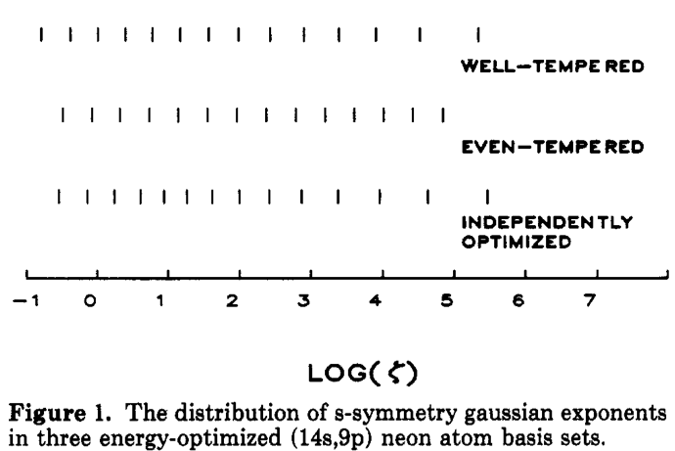
Davidson, E. R.; Feller, D. Chem. Rev. 1986, 86, 681-696.

Slide 10
Plane Wave Basis Sets
Used to model infinite systems (e.g. metals, crystals, etc.)
In infinite systems, molecular orbitals become bands
Electrons in bands can be described by a basis set of plane waves of the form
The wave vector k in a plane wave function is similar to the orbital exponent in a Gaussian function
Basis set size is related to the size of the unit cell rather than the number of atoms

Slide 11
Polarization Functions
Similar exponent as valence function
Higher angular momentum (l+1)
Uncontracted Gaussian (coefficient=1)
Introduces flexibility in the wave function
by making it directional
Important for modeling chemical bonds

Slide 12
Diffuse Functions
Smaller exponent than valence functions
(larger spatial extent)
Same angular momentum as valence
functions
Uncontracted Gaussian (coefficient=1)
Useful for modeling anions, excited states and weak (e.g., van der Waals) interactions

Slide 13
Cartesian vs. Spherical
Cartesians:
s – 1 function
p – 3 functions
d – 6 functions
f – 10 functions
Sphericals:
s – 1 function
p – 3 functions
d – 5 functions
f – 7 functions
Look at the d functions:
In chemistry, there should be 5 d functions (usually chosen to be ,
, , , and . These are “pure angular momentum” functions.
But it is easier to write a program to use Cartesian functions ( , , ,
, , and .

Slide 14
Cartesian vs. Spherical
Suppose we calculated the energy of HCl using a cc-pVDZ basis set using Cartesians then again using sphericals.
Which calculation produces the lower energy? Why?

Slide 15
Pople Basis Sets
Optimized using Hartree-Fock
Names have the form
k-nlm++G** or k-nlmG(…)
k is the number of contracted Gaussians used for core
orbitals
nl indicate a split valence
nlm indicate a triple split valence
+ indicates diffuse functions on heavy atoms
++ indicates diffuse functions on heavy atoms and hydrogens

Slide 16
Pople Basis Sets
Examples:
6-31G Three contracted Gaussians for the core with the valence represented by three contracted Gaussians and one
primitive Gaussian
6-31G* Same basis set with a polarizing function added
6-31G(d) Same as 6-31G*
6-31G** Polarizing functions added to hydrogen and heavy atoms
6-31G(d,p) Same as 6-31G**
6-31++G 6-31G basis set with diffuse functions on hydrogen and
heavy atoms
The ** notation is confusing and not used for larger basis sets:
6-311++G(3df, 2pd)

Slide 17
Dunning Correlatoin Consistent Basis Sets
Optimized using a correlated method (CIS, CISD, etc.)
Names have the form
aug-cc-pVnZ-dk
“aug” denotes diffuse functions (optional)
“cc” means “correlation consistent”
“p” indicates polarization functions
“VnZ” means “valence n zeta” where n is the number of functions used to describe a valence orbital
“dk” indicates that the basis set was optimized for relativistic calculations
Very useful for correlated calculations, poor for HF
Size of basis increases rapidly with n

Slide 18
Dunning Basis Sets
Examples:
cc-pVDZ Double zeta with polarization
aug-cc-pVTZ Triple zeta with polarization and
diffuse functions
cc-pV5Z-dk Quintuple zeta with polarization optimized for relativistic effects

Slide 19
Extrapolate to complete basis set limit
Most useful for electron correlation methods
P(l_{max}) = P(CBS) + A( l_{max})⁻³
P(n) = P(CBS) + A( n)⁻³
n refers to cc basis set level: for for DZ, 3 for TZ, etc.
Best to use TZP and better
http://molecularmodelingbasics.blogspot.dk/2012/06/complete-basis-set-limit-extrapolation.html
TCA, 99, 265 (1998)

Slide 20
Basis Set Superposition Error
Occurs when a basis function centered at one nucleus contributes the the electron density around another nucleus
Artificially lowers the total energy
Frequently occurs when using an unnecessarily large basis set (e.g. diffuse functions for a cation)
Can be corrected for using the counterpoise correction.
- Counterpoise usually overcorrects
- Better to use a larger basis set
Notes:
Jensen 225 – 227

Slide 21
Counterpoise Correction
E(A)_{ab} is the energy of fragment A with the basis functions for A+B
E(A)_{a} is the energy of fragment A with the basis functions centered on fragment A
E(B)_{ab} and E(B)_{b} are similarly defined

Slide 22
Additional Information
EMSL Basis Set Exchange:
https://bse.pnl.gov/bse/portal
Further reading:
Davidson, E. R.; Feller, D. Chem. Rev. 1986, 86, 681-696.
Jensen, F. “Introduction to Computational Chemistry”, 2nd
ed., Wiley, 2009, Chapter 5.

Slide 23
Effective Core Potentials (ECPs) and Model Core Potentials (MCPs)

Slide 24
Frozen Core Approximation
All electron Fock operator:
Partition the core (atomic) orbitals and the valence orbitals:
Introduce a modified nuclear charge ( ):
V_{Coulomb}
V_{Exchange}
Approximation made: atomic core orbitals are not allowed to
change upon molecular formation; all other orbitals stay
orthogonal to these AOs

Slide 25
Pseudopotentials - ECPs
Effective core potentials (ECPs) are pseudopotentials that
replace core electrons by a potential fit to all-electron
calculations. Scalar relativisitc effects (e.g. mass-velocity
and Darwin) are included via a fit to relativistic orbitals.
Two schools of though:
Shape consistent ECPs
(e.g. LANLDZ RECP, etc.)
Energy consistent ECPs
(e.g. Stüttgart LC/SC RECP, etc.)

Slide 26
Shape Consistent ECPs
Nodeless pseudo-orbitals that resemble the valence orbitals in the
bonding region
Original orbital in the outer region
Smooth polynomial expansion in the
inner region
The fit is usually done to either the large component of the Dirac wave
function or to a 3rd order Douglas-Kroll wave function
Creating a normalized shape consistent orbital requires mixing in
virtual orbitals
Usually gives accurate bond lengths and structures

Slide 27
Energy Consistent ECPs
Approach that tries to reproduce the low-energy atomic spectrum
(via correlated calculations)
Usually fit to 3rd order Douglas-Kroll
Difference in correlation energy due to the nodeless valence orbitals is
included in the fit
Small cores are still sometimes necessary to obtain reliable results
(e.g. actinides)
Cheap core description allows for a good valence basis set (e.g. TZVP)
Provides accurate results for many elements and bonding situations

Slide 28
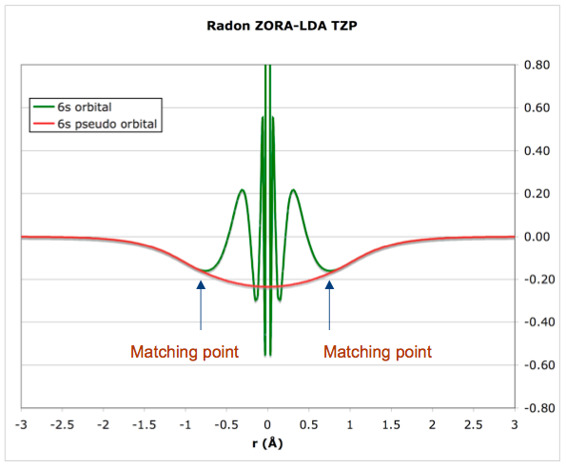
Pseudo-orbitals
Visscher, L., “Relativisitic Electronic Structure Theory”, 2006 Winter School, Helkinki, Finland.

Slide 29
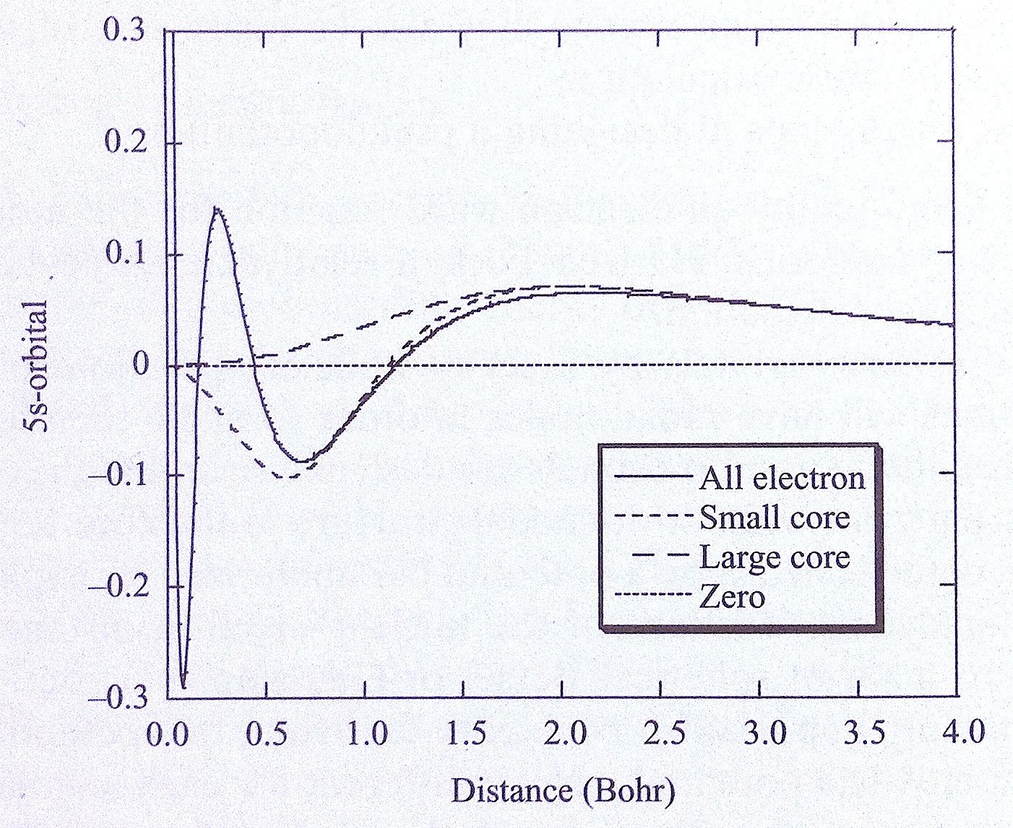
Large and Small Core ECPs
Jensen, Figure 5.7, p. 224.

Slide 30
Pseudopotentials - MCPs
Model Core Potentials (MCP) provide a
computationally feasible treatment of heavy elements.
MCPs can be made to include scalar relativistic effects
- Mass-velocity terms
- Darwin terms
Spin orbit effects are neglected.
- Inclusion of spin-orbit as a perturbation has been
proposed
MCPs for elements up to and including the lanthanides
are as computationally demanding as large core ECPs.

Slide 31
MCP Formulation
All-electron (AE) Hamiltonian:
MCP Hamiltonian:
First term is the 1 electron MCP Hamiltonian
Second term is electron-electron repulsion (valence only)
Third term is an effective nuclear repulsion
Huzinaga, S.; Klobukowski, M.; Sakai, Y. J. Phys. Chem. 1982, 88, 21.
Mori, H; Eisaku, M Group Meeting, Nov. 8, 2006.

Slide 32
1-electron Hamiltonian
All-electron (AE) Hamiltonian:
MCP Hamiltonian:
First term is the 1 electron MCP Hamiltonian
Second term is electron-electron repulsion (valence only)
Third term is an effective nuclear repulsion
Huzinaga, S.; Klobukowski, M.; Sakai, Y. J. Phys. Chem. 1982, 88, 21.
Mori, H; Eisaku, M Group Meeting, Nov. 8, 2006.

Slide 33
MCP Nuclear Attraction
A_{I}, α_{I}, B_{J}, and β_{J} are fitted MCP parameters
MCP parameters are fitted to 3rd order Douglas-Kroll orbitals
Huzinaga, S.; Klobukowski, M.; Sakai, Y. J. Phys. Chem. 1982, 88, 21.
Mori, H; Eisaku, M Group Meeting, Nov. 8, 2006.

Slide 34
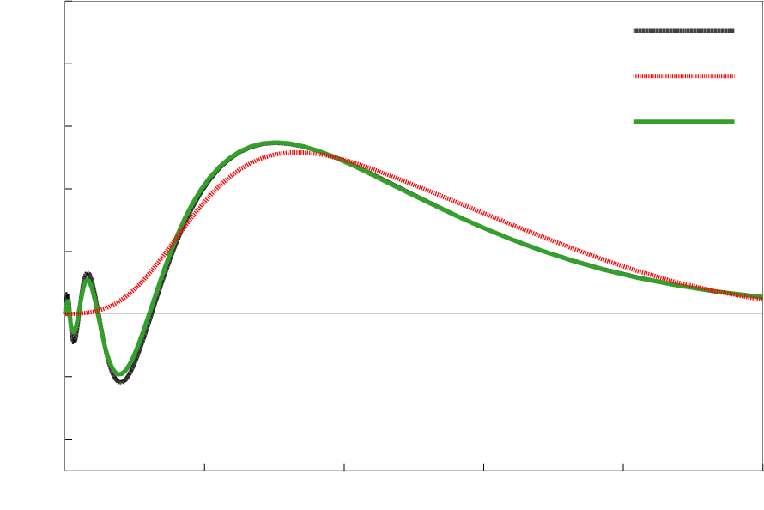
MCP vs. ECP
6s Orbital of Au atom
QRHF
ECPs “smooth out” the core, eliminating the radial nodal structure
MCPs retain the correct radial nodal structure
0.8
ECP
MCP
0.4
rR(r) / a.u.
0.0
-0.4
0
2
4
6
8
10
r / a.u.
Mori, H; Eisaku, M Group Meeting, Nov. 8, 2006.

